Slide 1

DevOps & Cloud Infrastructure SEIS 665 Week 11
Jason Baker
Adjunct Instructor
Graduate Programs in Software
University of St. Thomas
St. Paul, MN

Slide 2
Agenda
What is DevOps?
Lean theory
DevOps Culture
Design For Operations
Infrastructure as code
DevOps Pipeline

Slide 3
DevOps Defined
DevOps is a culture, movement or practice that emphasizes the collaboration and communication of both software developers and other IT professionals while automating the process of software delivery and infrastructure changes.
-- Wikipedia

Slide 4
Is DevOps really new?
Operations staff have been automating system configurations for decades
Shell scripts
PXE boots
VMWare templates
Developers have also been automating software releases
Make, Ant, CVS…
Despite decades of effort, we still have problems...

Slide 5
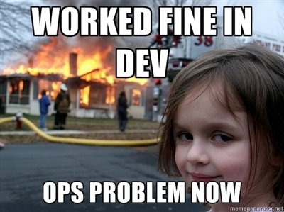

Slide 6
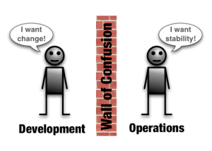

Slide 7

Conflicting measures of success
Development success is measured by the number of changes added to a release.
Operations success is measured by how long the service stays up.

Slide 8
IT Change Management
Traditionally, in IT we would manage the risk of change by:
Changing as infrequently as possible
Changing at inconvenient times when staff and vendors are at their lowest performance levels
Batching changes during a change window

Slide 9

The Slippery Slope Theory of Change Management
Change is risky.
Because of this risk, we don’t make changes often.
But the longer we wait to make changes, the more things we have to change.
The more things we have to change, the greater the risk.
There, changing less often increases risk.

Slide 10

What’s DevOps
DevOps addresses traditional IT challenges, but what is it?

Slide 11
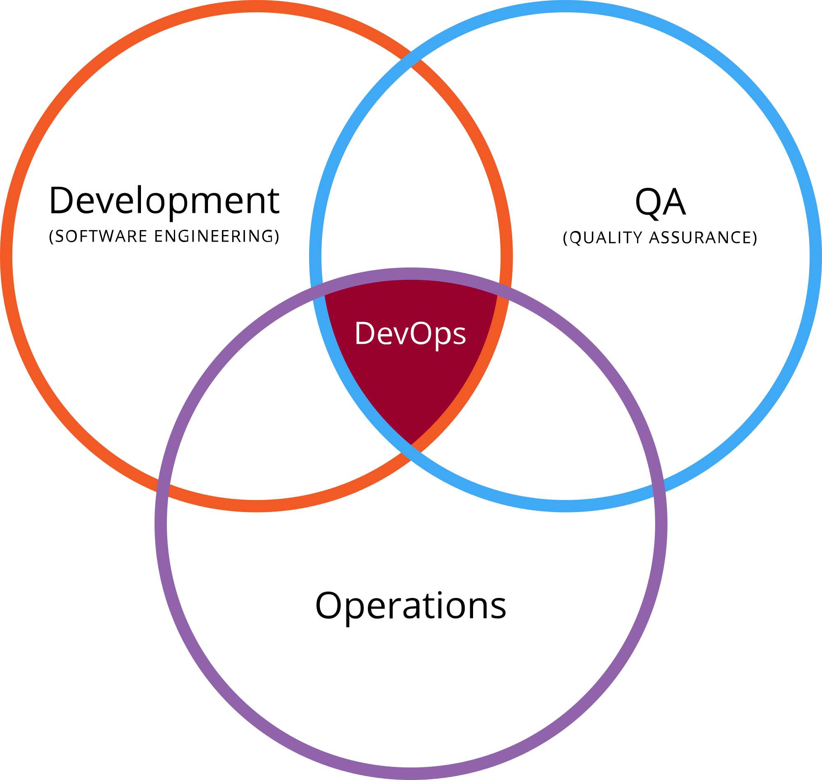
What is DevOps?
A methodology combining multiple practices within the IT organization.

Slide 12
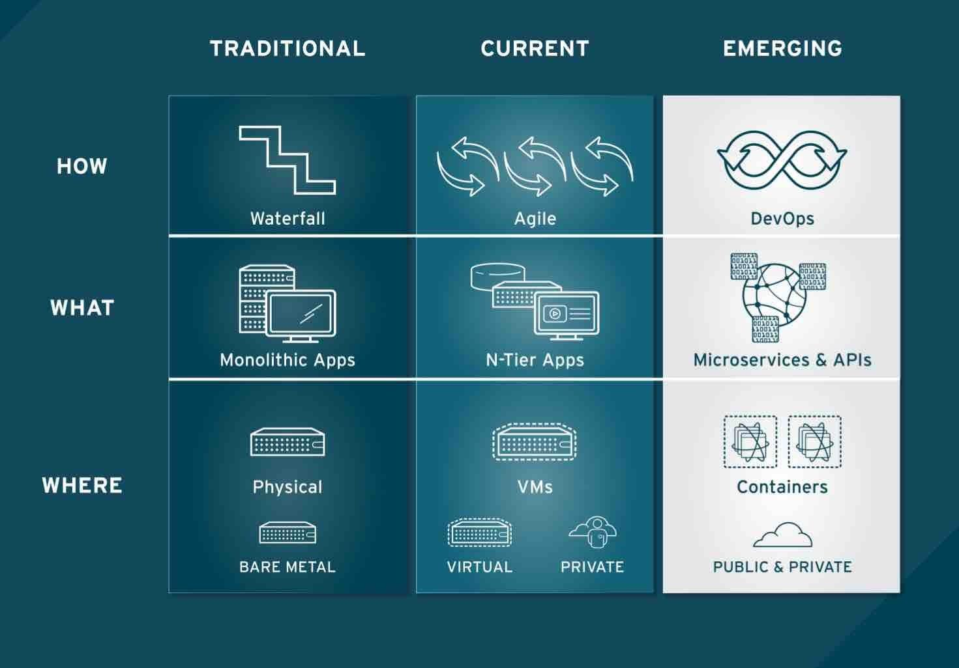
What is DevOps?
The evolution of technology.

Slide 13
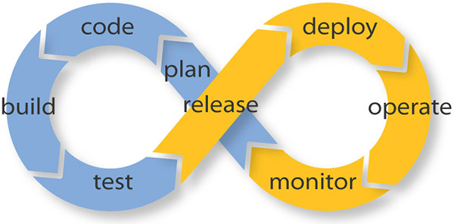
What is DevOps?
A collaborative effort to improve the quality and velocity of the service lifecycle.

Slide 14
Why does DevOps matter?
2016 State of DevOps Report
Survey of over 25,000 technology professionals over 5 years
Try to understand how technical and cultural practices associated with DevOps affect IT performance
Categorized IT organizations as High, Medium or Low performers

Slide 15
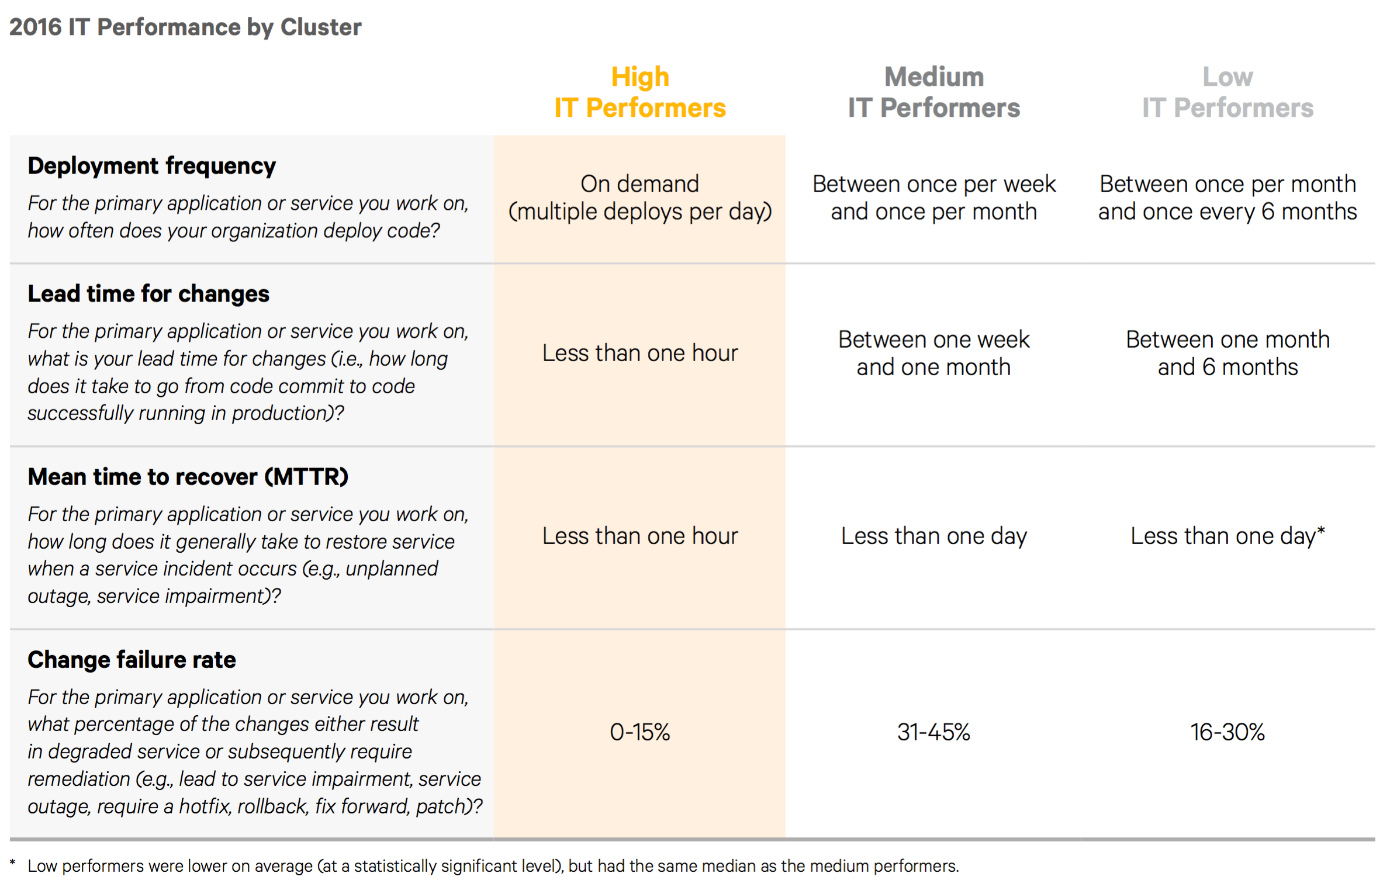

Slide 16
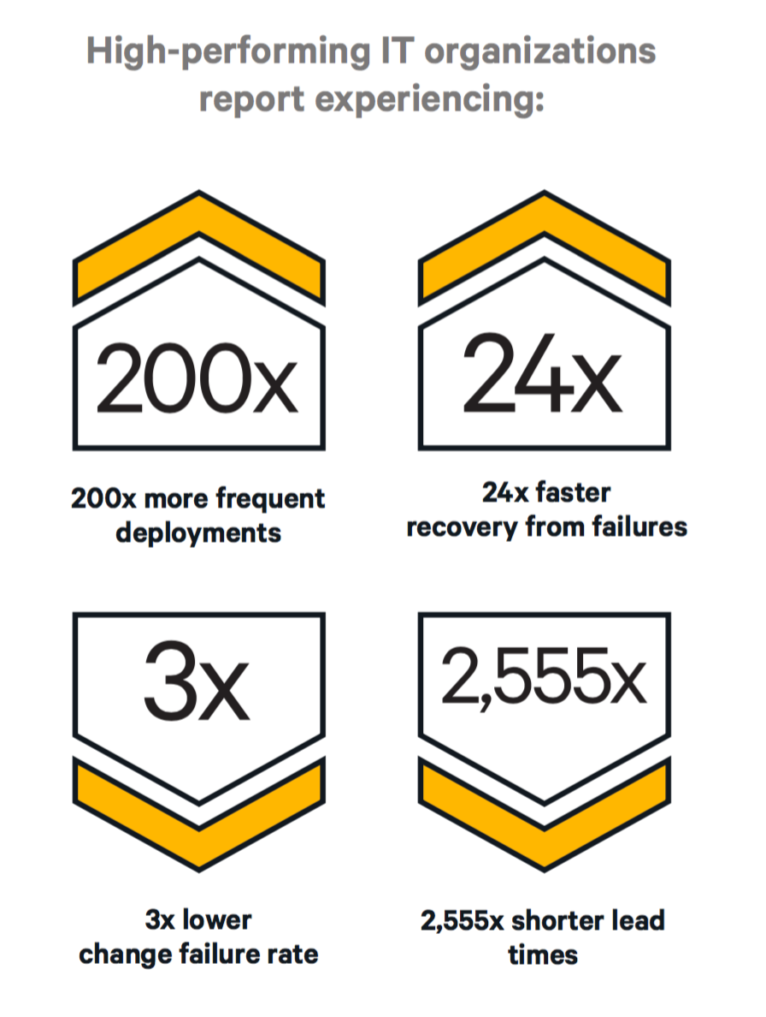
Source: 2016 State of DevOps Report

Slide 17
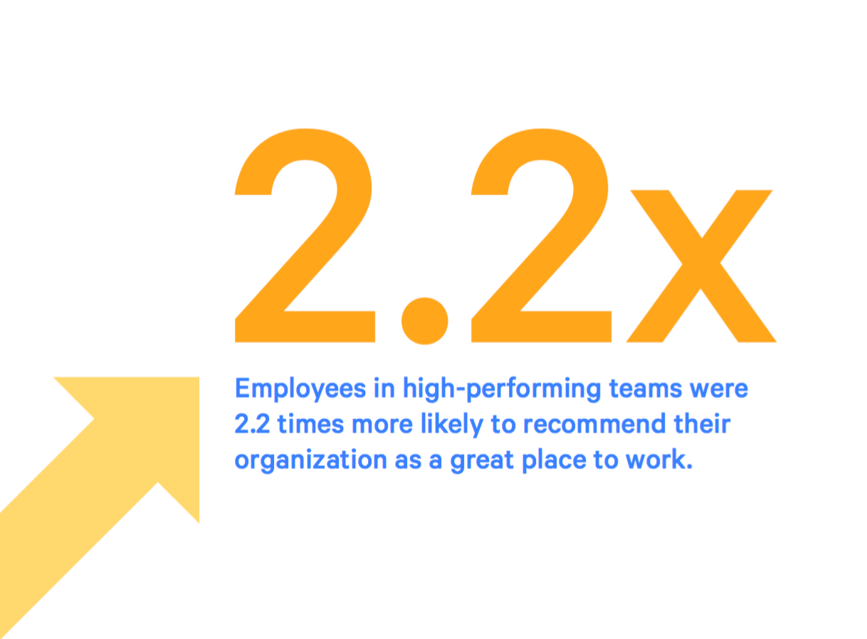
Source: 2016 State of DevOps Report

Slide 18

3 pillars of DevOps
Culture
Automation
Measurement

Slide 19
Common DevOps Misconceptions
We have to hire special DevOps people and build a DevOps team.
DevOps is about breaking down silos, not creating new ones.
DevOps is just automation.
No, DevOps is focused on improving service delivery from design to release.
Using DevOps tools makes you a DevOps shop.
Tooling supports DevOps, it doesn’t create it.

Slide 20

DevOps Culture

Slide 21
Cultural priorities
Collaborative
Teams are multi-disciplined and focused on service delivery (the greater good)
Transparent
People share information with one another
Blame-less environment
Change oriented
Change is expected and embraced.
Developing a DevOps culture is the hard part!

Slide 22
Does my organization have a DevOps culture?
Do our developers and operations people sit near one another and go to lunch together?
Do ops people regularly attend inception, showcase, and retrospective meetings?
And do devs go to ops standups?
Do developers rotate through the operations team?

Slide 23
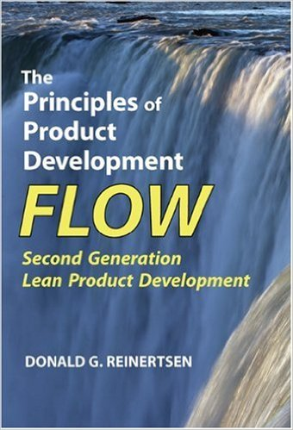
DevOps Culture & Lean
DevOps culture is heavily influenced by Lean practices
Lean is a wide-spread methodology in manufacturing
Commonly implemented as Six Sigma practices
Goals:
Eliminate waste within a system (“Muda”)
Improve product quality
Respect for people
Continuous improvement (“Kaizen”)

Slide 24
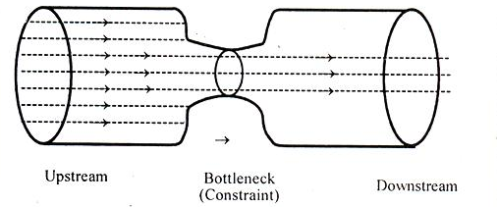
Theory of Constraints
Developed by Eliyahu Goldratt:
Think of your process as a chain of links
Improving strong links doesn’t strengthen the chain
Improve the weakest link first

Slide 25
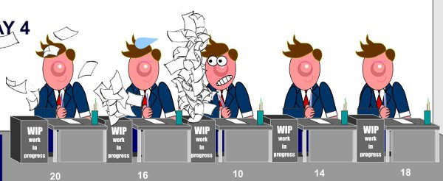
Theory of Constraints
Example: If it requires 40 hours of effort to test a release and 10 minutes to deploy it, then the testing process is a constraint on improving cycle time.

Slide 26
Lean Queuing Theory
How do we push (or pull) work through a system?
Traditional utilization thinking: focus on operating resources at peak capacity
Optimize locally rather than at the system level
Throughput thinking: focus on identifying the constraints that reduce delivery effectiveness
Software development is a stochastic system with queues (non-linear and non-deterministic)
Behavior of this type of system defies our instincts
Large projects (batch sizes) increase cycle time
Take longer to process leading to variability and more queues
Increasing worker utilization makes it worse!!
Little’s Law: The only way to maximize throughput is by minimizing Work In Progress (WIP) through the system using small batch sizes.
Small Agile sprints or Kanban tasks
Source: https://less.works/less/principles/queueing_theory.html

Slide 27

Build a service, not software.

Slide 28
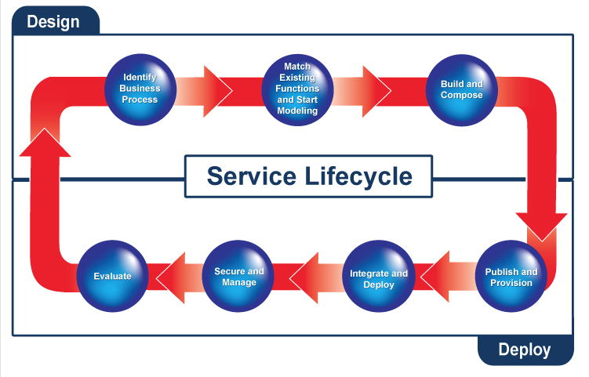
Developer-land
Operations-land

Slide 29
DevOps Team Focus
Developers more focused on earlier phases of lifecycle.
Operations more focused on later phases of lifecycle.
Both are accountable for service delivery.
Identify requirements
Modeling
Build & Compose
Publish & Provision
Integrate & Deploy
Secure & Manage
Operations
Focus level
Developers

Slide 30
Design For Operations
Problem: Software designs oftentimes don’t account for deployment, management, and support phases.
Non-functional requirements:
How will we scale this feature?
How will we provide high availability?
How will our customer service team support this?
In a DevOps culture, operations staff participate in software planning discussions.
Operations ensures non-functional requirements are part of the software design
Availability, Scalability, Upgradeability, Supportability, Testability, etc

Slide 31
Developers role
Developers participate in service delivery and support
Builds accountability: “Eat your own dog food”.
Developers are part of the on-call support team.
If Developers provide service delivery support, do they get root?
Not necessarily, but they should have enough access to troubleshoot common issues.
Full access to all infrastructure and application logs
Full access to metrics
Ability to remediate issues by pushing out corrective updates

Slide 32
Transparency
In DevOps organizations, staff are empowered to improve quality.
Lean principle: anyone can stop the production line at any time.
Everyone works together to solve the quality problem.
It’s the highest priority job.
Service issues are addressed at postmortem meetings
Scheduled no later than 48 hours after incidents
Focus on determining root cause, not assigning blame
Corrective action given the highest priority

Slide 33
Transparency
A transparent, blameless environment is a safer environment for employees.
More willing to participate in discussions and raise awareness of potential problems.
Employees won’t hide mistakes.
More willing to experiment and test ways to improve the service.
Survey statistics show that employees are happier in this environment.

Slide 34
Embrace Change
DevOps cultures recognize that change is inevitable, so they embrace it.
Lean/Agile: Smaller batch sizes = increasing rate of change
The more we change, the better we get at it.
Sports teams can’t get together every 3 months and expect to win a championship. They have to practice.
Learn to change often
Monthly -> Weekly -> Daily -> Hourly
Should be able to push most changes at any time of day without impacting services
Amazon & Netflix deploy thousands of times a day.

Slide 35
Embrace Change
But some changes can’t happen in the middle of the day like database schema changes, right?
Many database changes do not require a service maintenance window if designed and sequenced carefully.
Zero Downtime Deployment
Change process may require multiple software updates to transform the schema from one version to another.
Evolutionary Database Design
This process is hard for traditional organizations because their cycle time is too long.
It’s easier to just disrupt the service and push in the change.

Slide 36

Automation

Slide 37
Automation
DevOps mantra: Automate (almost) everything.
Humans are brittle.
Processes must be repeatable.
Best way to reduce cycle time and improve quality.
Most cost effective way to scale work.

Slide 38
Software Assembly Line
DevOps treats software development and running a service like an automated manufacturing line.
Design the product
Assemble it
Test it
Package it for deployment
Work moves through the company, queuing up at various stations.
For example: product backlog and QA tests are very visible sorts of queues

Slide 39
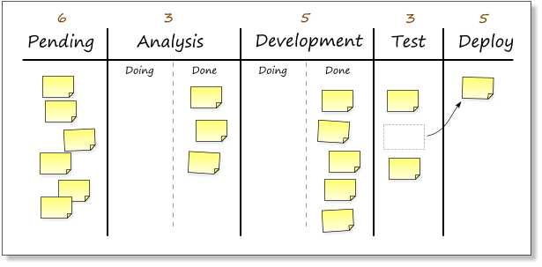
Software Assembly Line
Example: Kanban board showing queues

Slide 40
Software Assembly Line
Once again, DevOps adopts lessons from Lean
W. Edwards Deming: “Cease dependence on inspection to achieve quality. Build quality into the product.”
Oftentimes companies focus their efforts on finding defects versus preventing defects.
Manual exploratory testing
End-to-end testing
User Acceptance testing

Slide 41
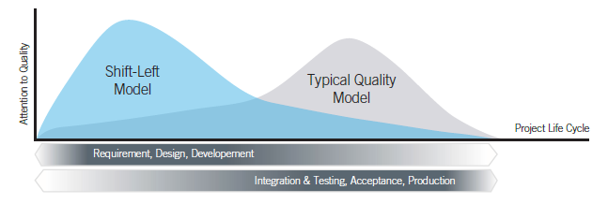

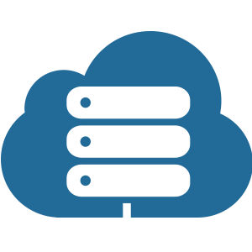
Shift Left
DevOps adopts a “Shift Left” Lean alignment to increase focus on quality issues earlier in the development process.

Slide 42
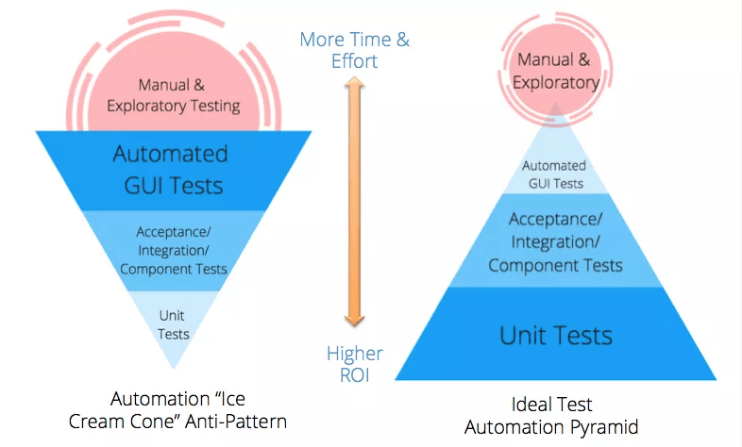
Shift Left

Slide 43
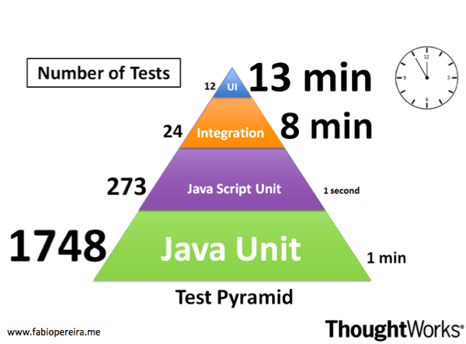
Example Testing Pyramid

Slide 44
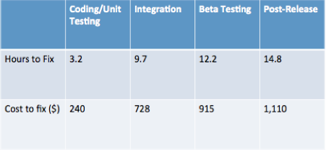
Shift Left
Why does shifting left improve quality and reduce costs in software development?
It’s easier to automate testing when the test is done as close to the code as possible (bake quality into the product).
It’s much easier for a developer to fix a defect found during unit testing than in integration testing or deployment.
Data Source: (Planning Report 02-3, “The Economic Impacts of Inadequate Infrastructure for Software Testing,” Prepared by RTI for National Institute of Standards and Technology, May 2002, p 7-12.)

Slide 45
Continuous Integration
Continuous Integration is a practice where developers continuously commit code changes to a mainline branch.
Originated as part of Extreme Programming practices.
Your software is broken until somebody proves it works.
Traditionally, developers would merge code changes once a day and do a nightly build.
Don’t break the build!
Developers would work on separate long-running feature branches and face “merge hell”.
Benefit: deliver faster software changes with fewer bugs (which are caught earlier).

Slide 46

Continuous Integration Practices
Developers check-in code at least once a day to one branch.
Code is built at every check-in.
Code is unit tested at every check-in.
Everyone can view the build and test reports.
Developers get fast feedback from build – does it still work?
Deliverables are stored in an artifact repository and deployed to a test environment after a successful build.
Source: www.continuousdelivery.nu

Slide 47
Feature Toggle Pattern
What about features that take a long time to develop?
Work-in-progress features are deployed in releases. WHAT??
Use a configuration file to hide/disable the feature in production.
This process decreases software integration risks.
Very common pattern implemented by the largest Internet application development firms.

Slide 48
DevOps Pipeline
DevOps pipeline is an automated process for getting software from version control into the hands of your users.
It’s automated Continuous Integration.
Key benefits to this pattern:
Effectively prevents the deployment of code that has not been thoroughly tested
Development and release process becomes rapid, repeatable, and reliable.
Releases become normal events and can occur much more frequently.
Source: Continuous Delivery, Humble & Farley

Slide 49
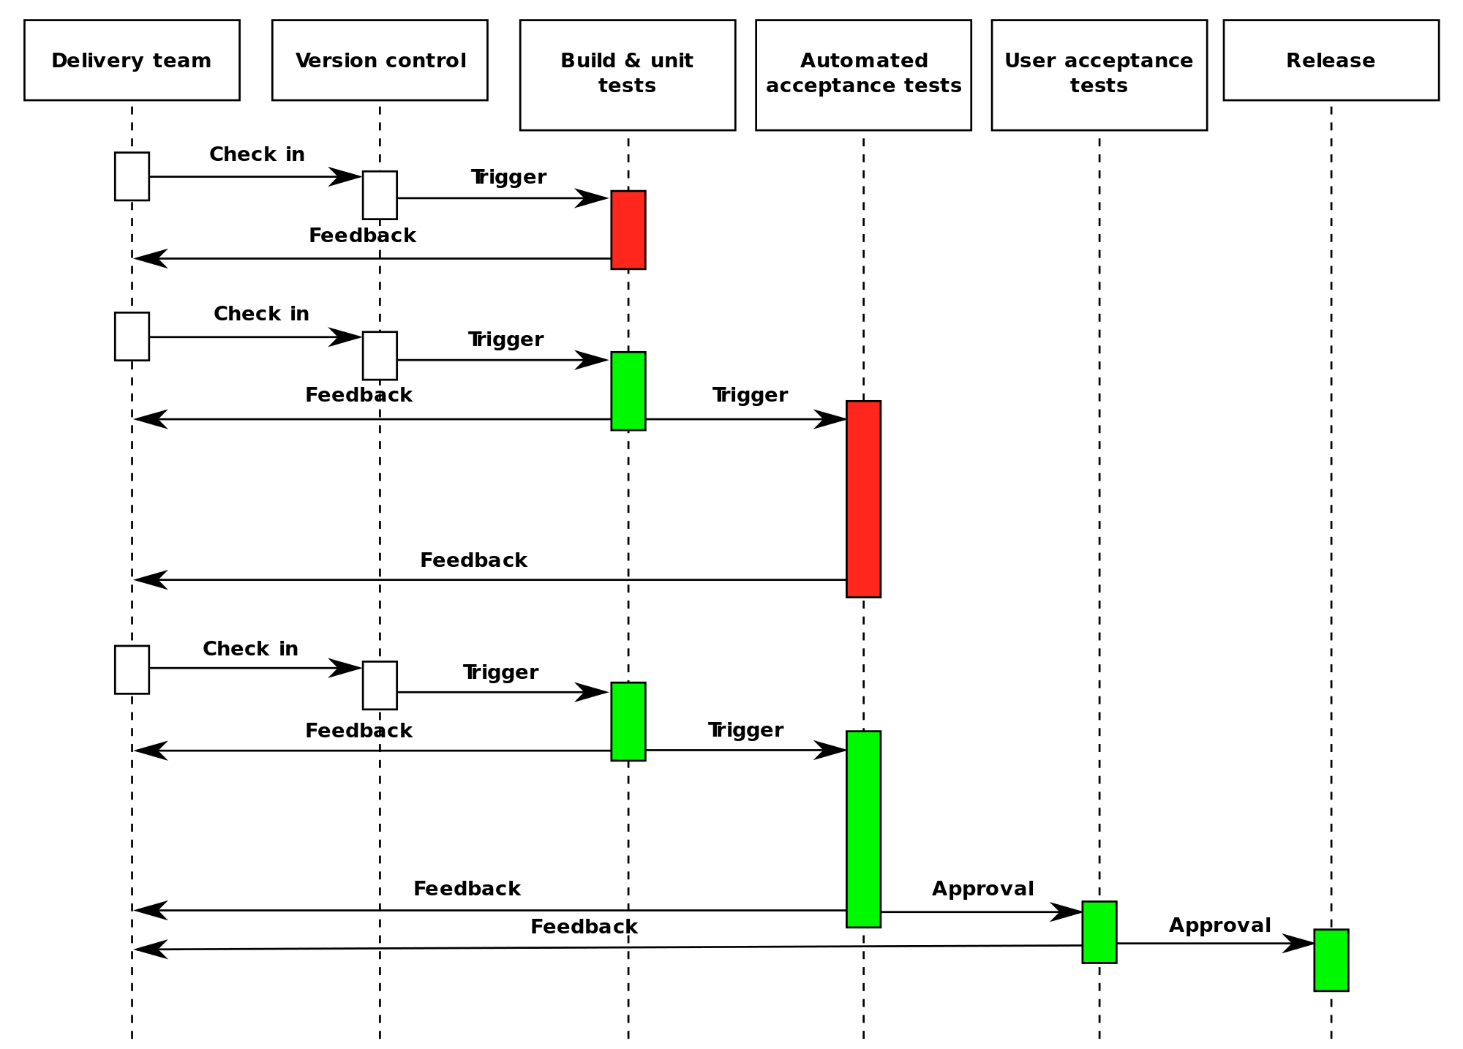

Slide 50
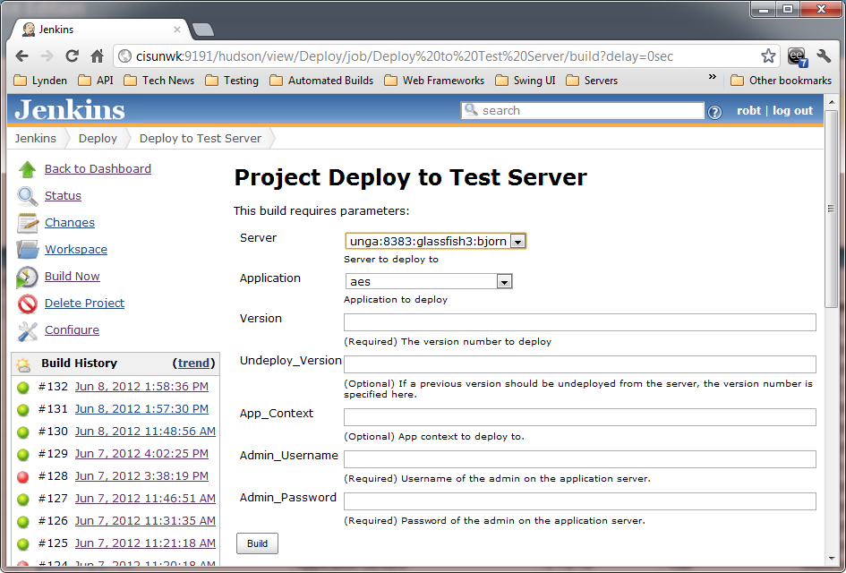

Slide 51
Deployment Pipeline Practices
Only build your binaries once.
Don’t keep re-compiling or packaging app at each stage to minimize introduction of configuration inconsistencies.
Store application artifacts in a repository (example: Artifactory)
Deploy the same way to every environment.
Use the same script to deploy to a dev laptop and a public cloud service
Store environment-specific configurations in separate files
If any part of the pipeline fails, stop the line.
If a deployment to an environment fails, the whole team owns that failure and every effort should be taken to fix it.

Slide 52
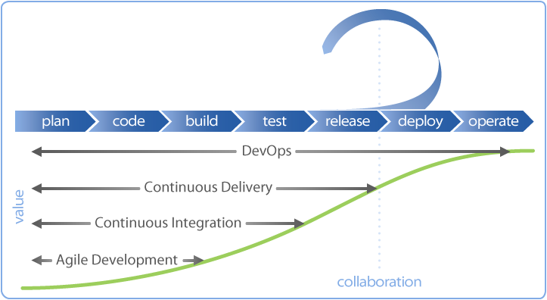
Continuous Delivery
Software is deployable throughout its lifecycle.
Team prioritizes keeping the software deployable over working on new features.
All parts of the pipeline are extensively automated including the deployment environment.
Done means released!

Slide 53
Infrastructure as Code
An approach to infrastructure automation based on practices used in software development.
Versionable, Testable, Repeatable
Goals
Infrastructure supports change and is no longer an obstacle
Infrastructure change is routine
Improvements are made continuously versus big bang releases

Slide 54
Infrastructure as Code
Challenges with dynamic infrastructure:
Server sprawl: it’s easy to create infrastructure
Configuration drift: infrastructure configuration changes creep in over time
Snowflake servers: the special servers everyone is afraid to touch
Automation fear: Running automation tools manually instead of unattended
Erosion: problems creep into running systems over time (Heroku)

Slide 55
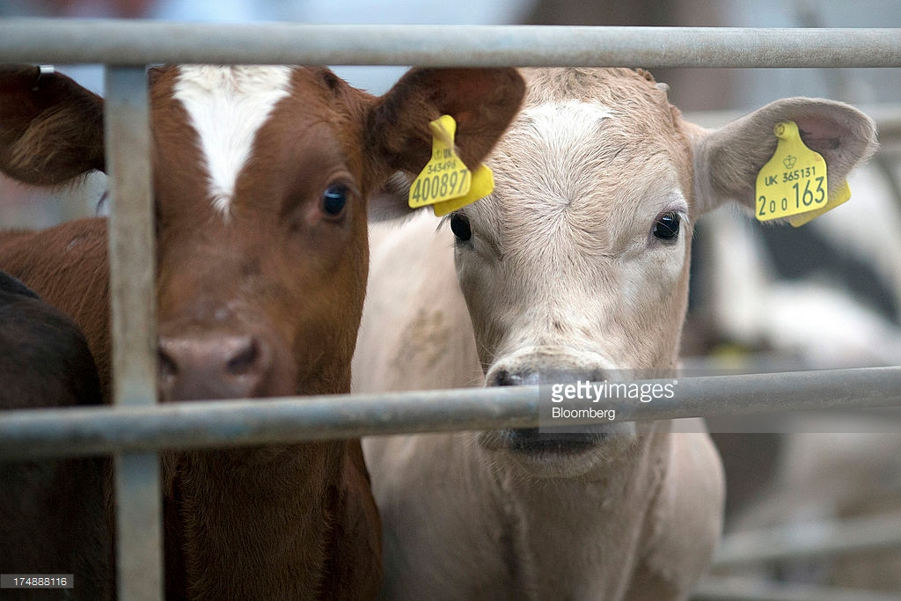
Infrastructure as Code
Core principles:
Systems can be easily reproduced like software builds
Systems are disposable
Treat your servers like cattle, not pets.
Systems are consistent
Infrastructure will always need to change
We use infrastructure definition and server configuration management tools to support these principles.
AWS Cloudstack, Openstack
Chef, Puppet, Ansible

Slide 56
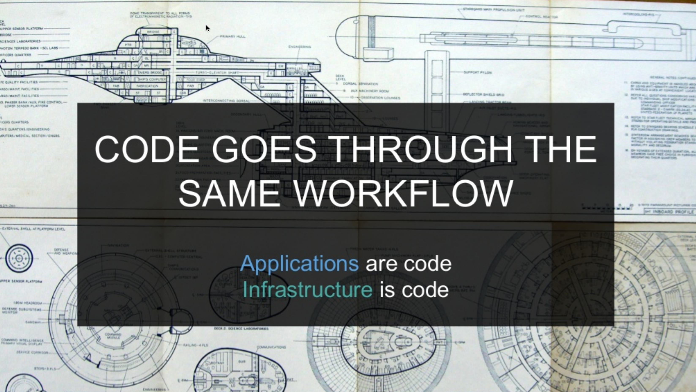

Slide 57
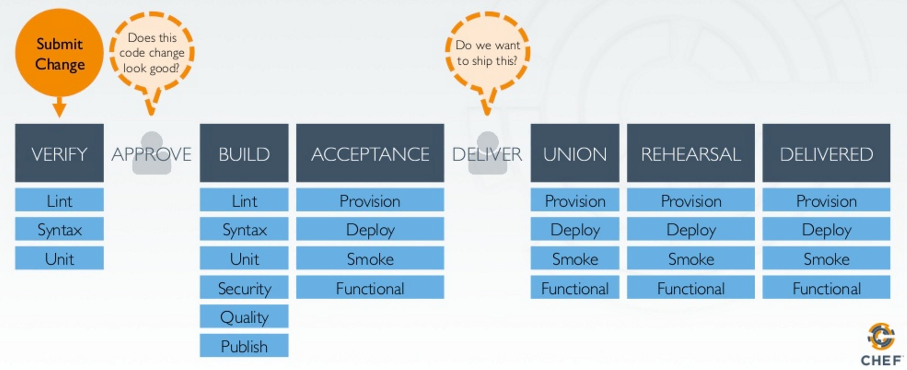
Change Management Pipeline

Slide 58
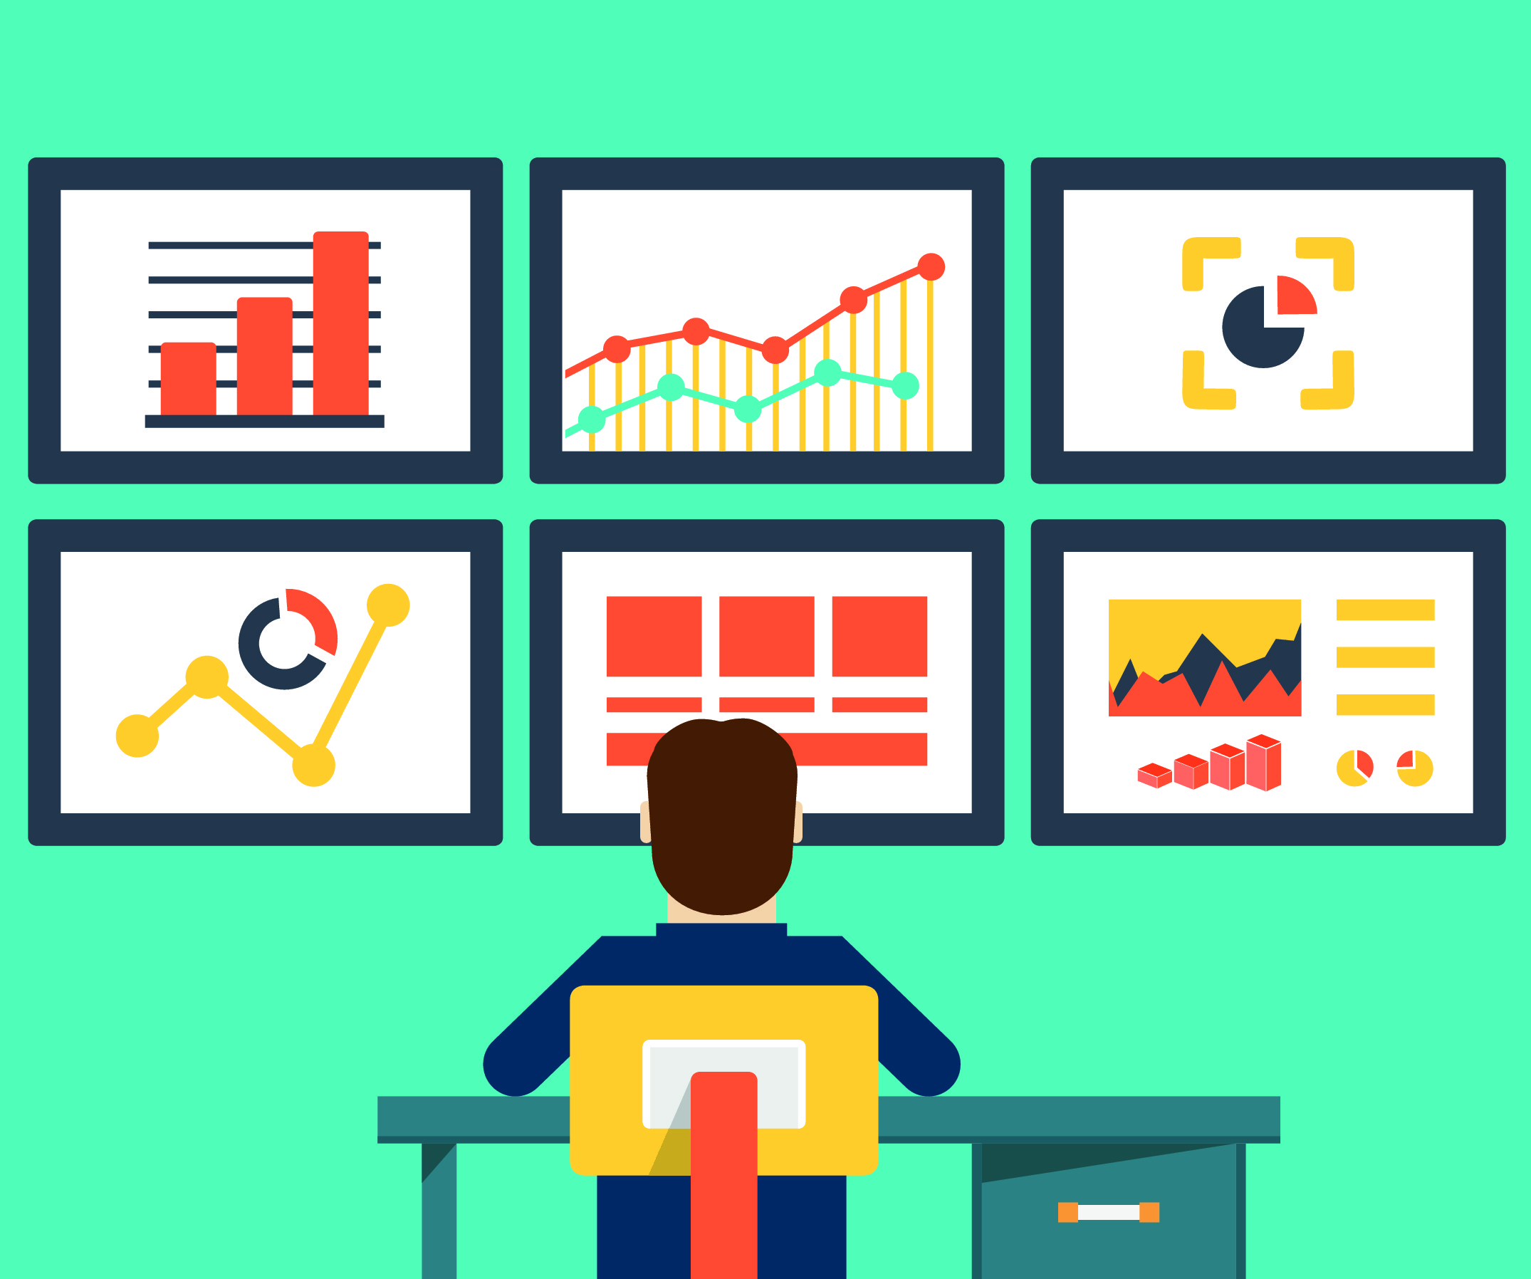
Metrics

Slide 59
Metrics
DevOps organizations ruthlessly collect data
You never know when you’ll need it.
Collect data from diverse resources and store in a central repository.
Time-series and unstructured data
Make it easy to search data to identify trends and correlations.

Slide 60
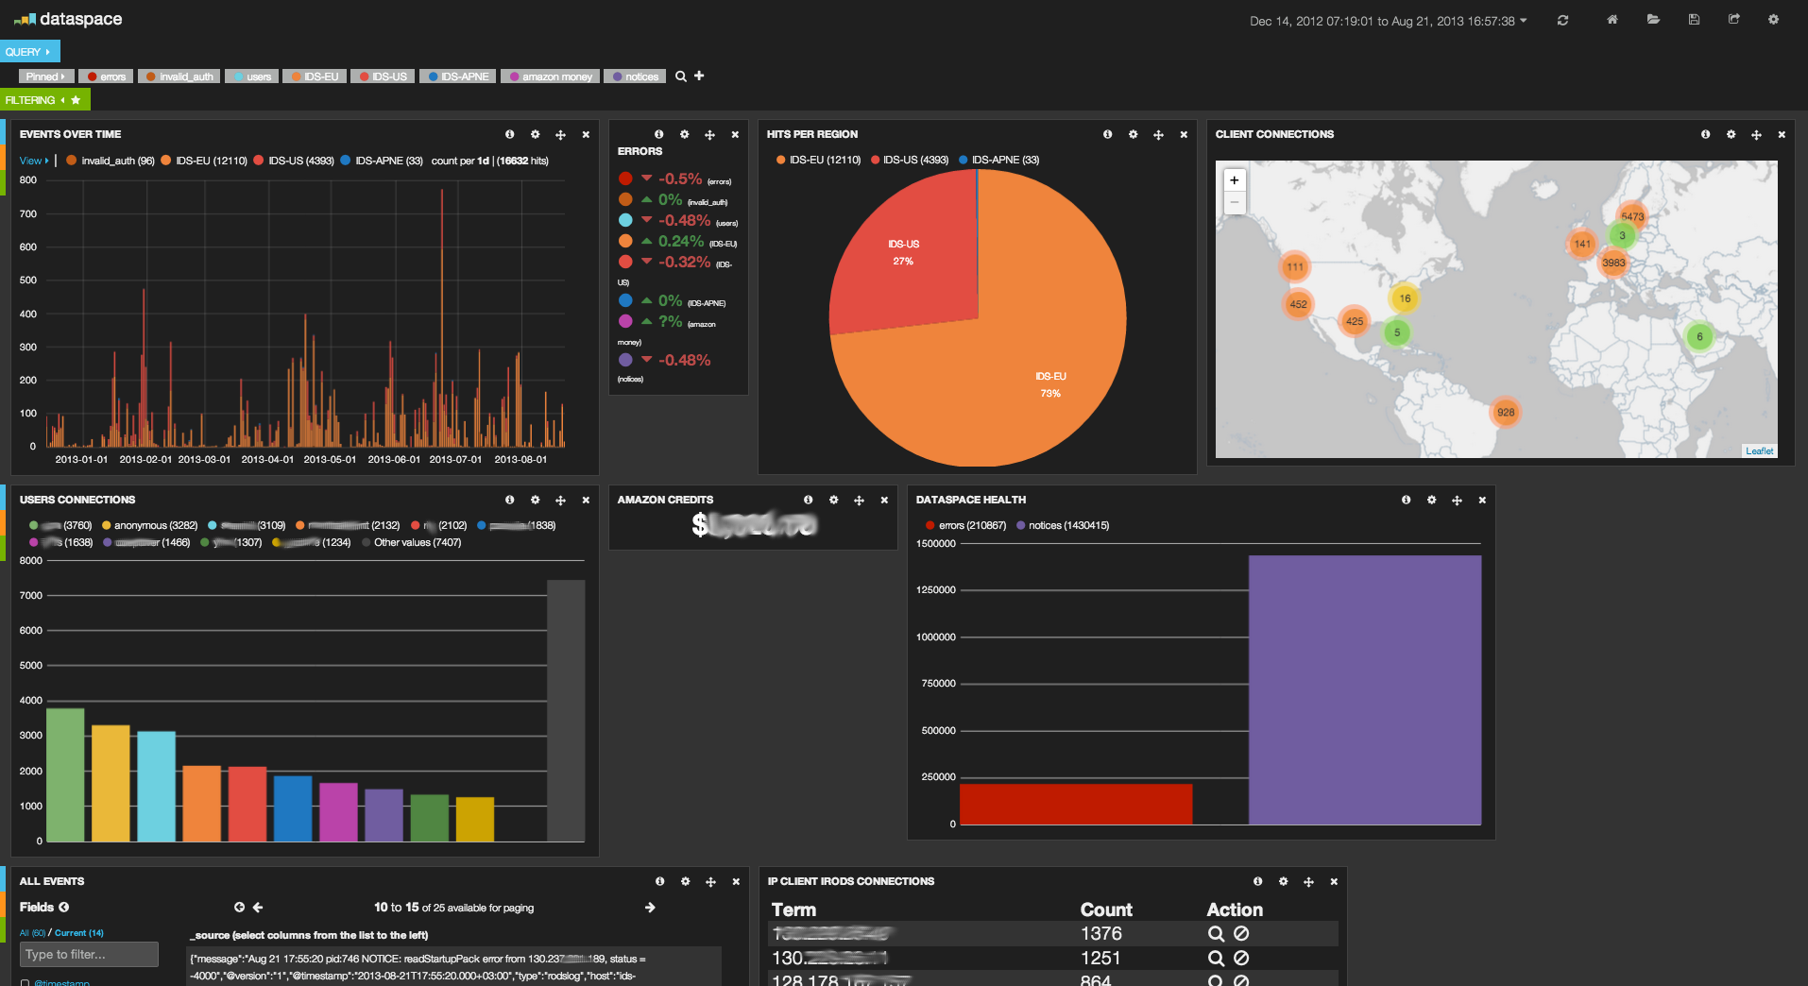
ELK Stack
Elasticsearch + Logstash + Kibana

Slide 61
KPIs
Identify Key Performance Indicators (KPIs) that measure:
Business: revenue, # orders, # support calls
Operations: Change error rate, incidents, ptime, response latency
Generate notifications to alert staff on service health issues
Weed out non-actionable notifications (log but don’t email)
Example: failing infrastructure is not actionable if the service is self-healing
Caveat: If a service is self-healing at a greater than expected rate, that might be actionable.

Slide 62

Metrics & Decision-making
Metrics drive decision-making in high performing DevOps organizations.
People perceive the world differently based on experiences and biases.
Oftentimes our technical solutions are educated guesses.
“I think if we add more memory the app performance will improve.”
DevOps uses metrics to support recommendations.
Any recommendation not supported by data is considered a guess and is therefore risky.
Cloud infrastructure gives us a cheap way to run experiments.

Slide 63

Parting Notes
You cannot change an organization into a DevOps unicorn overnight.
Culture is the hard part, tooling is easy in comparison.
Focus on optimizing the system to incrementally improve service delivery..

Slide 64
Homework
Assignment 10
Read Infrastructure as Code Chapters 11 & 12

